Slide 1
TRIP IT
Presented By-
Aditi Mishra(191500053)
Garima Singh Parihar(191500287)

Slide 2
OUTLINE
1)About the project
2)Objective
3)Requirements
4)User Interface
5)Future Scope
6)Conclusion

Slide 3
ABOUT THE PROJECT
“TRIP IT “is basically is a tour and travel web based application, which provides a convenient way for people to book places and get the knowledge of hotels, and various things for tour purposes.
We have developed TRIP IT to provide a search platform where a tourist can find their tour places according to their choices. This system also helps to promote tourism so that people can enjoy their holidays at their favorable places.

Slide 4
OBJECTIVE
The main objective of the project is to provide online registration, login, tour package information, ticket booking, online payment and searching facility for the customer and also generate details regarding the journey.
The system allows to easily access the relevant information and make necessary travel arrangements. Users can decide about places they want to visit and make bookings online.

Slide 5
REQUIREMENTS
SOFTWARE REQUIREMENTS
HARDWARE REQUIREMENTS
Technology implemented: Full stack
Language used: HTML, CSS, Javascript,
PHP
Database: MYSQL
User Interface: Graphical User Interface
Processor: intel i5
Operating System: Windows
RAM: 4 GB (or higher)
Hard disk: 1 Tb and more
Screen Size: 14 inch and more

Slide 6
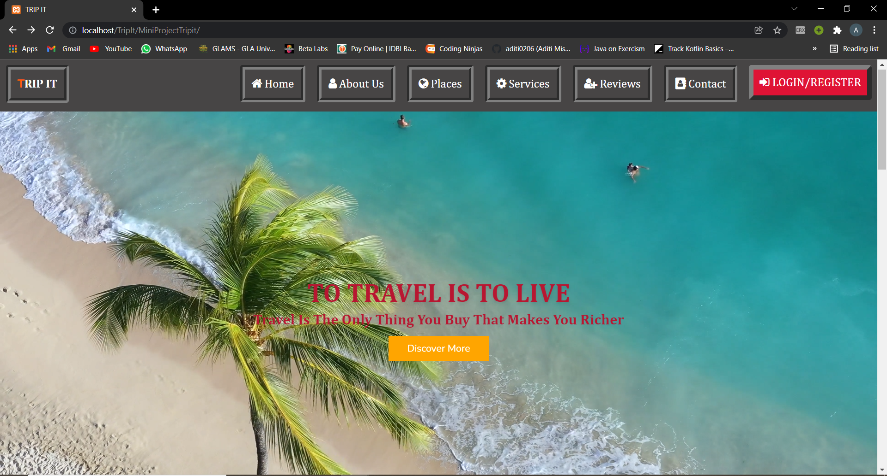
USER INTERFACE: HOME

Slide 7
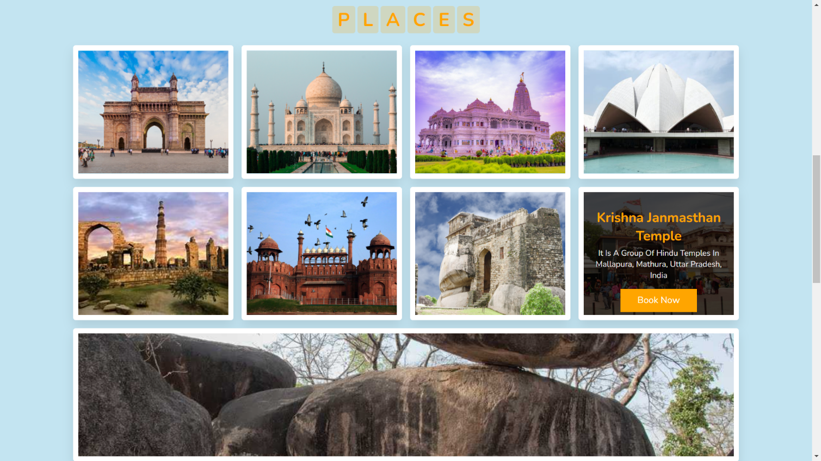
1B. HOME PAGE: PLACES

Slide 8
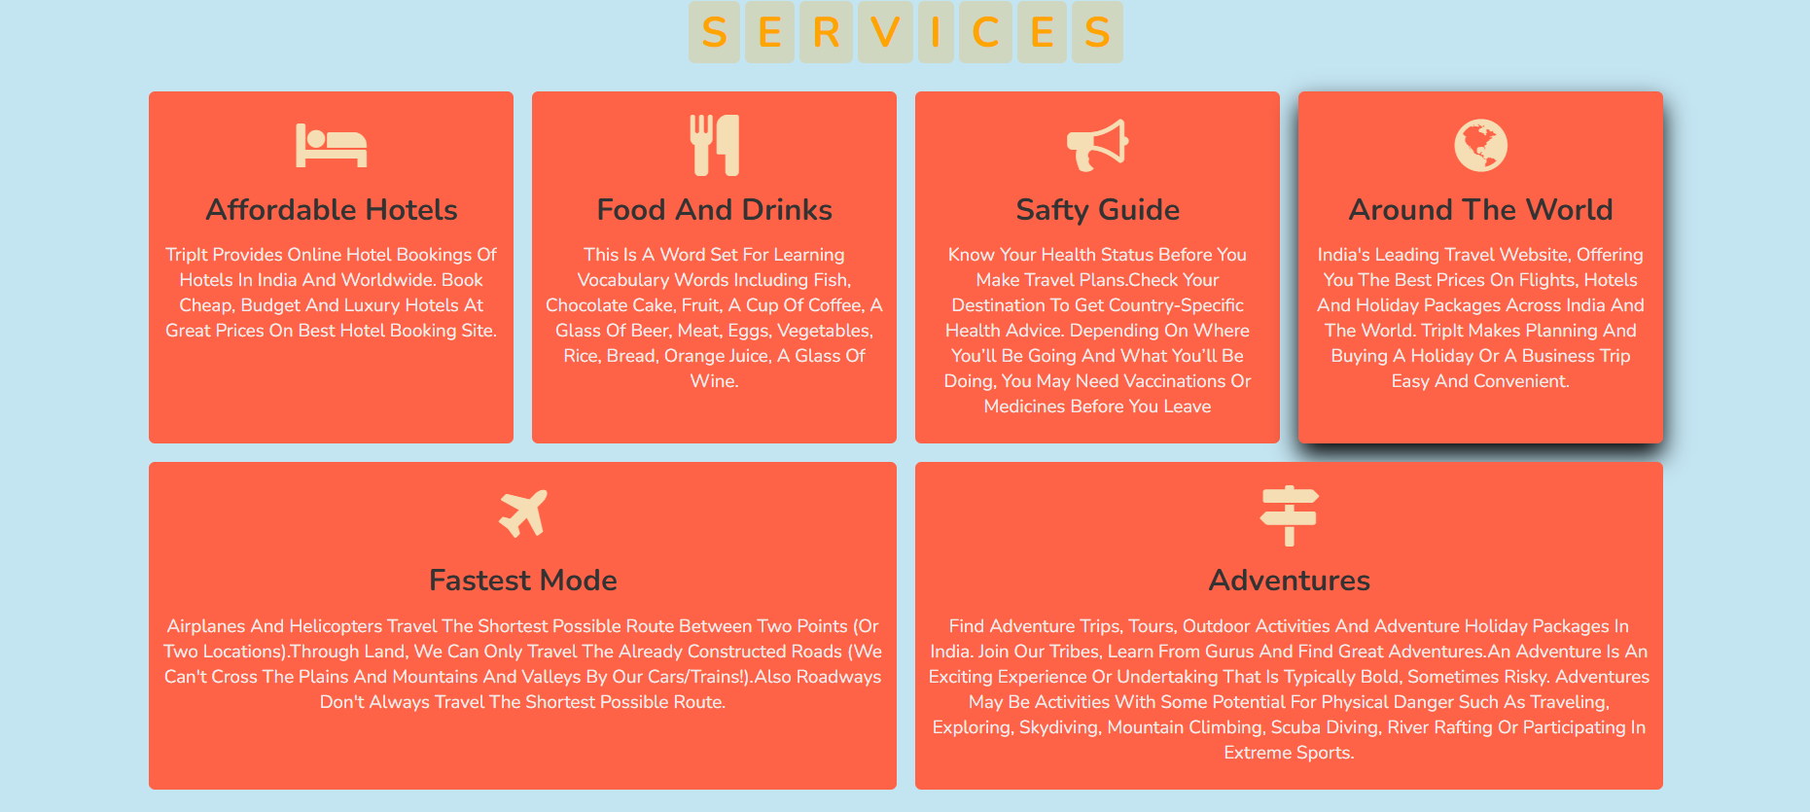
1C. HOME PAGE: SERVICES

Slide 9
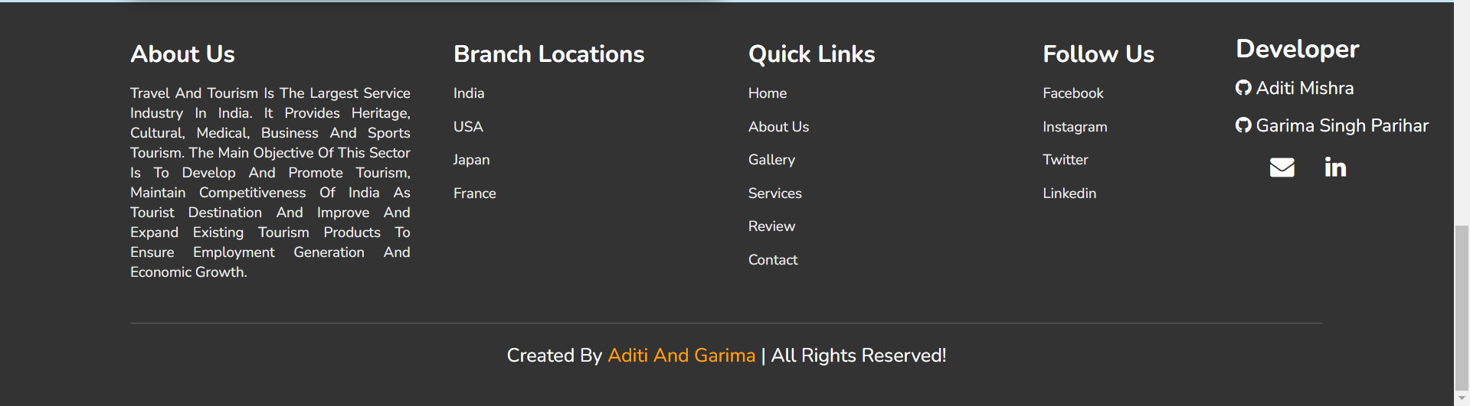
1D. FOOTER

Slide 10
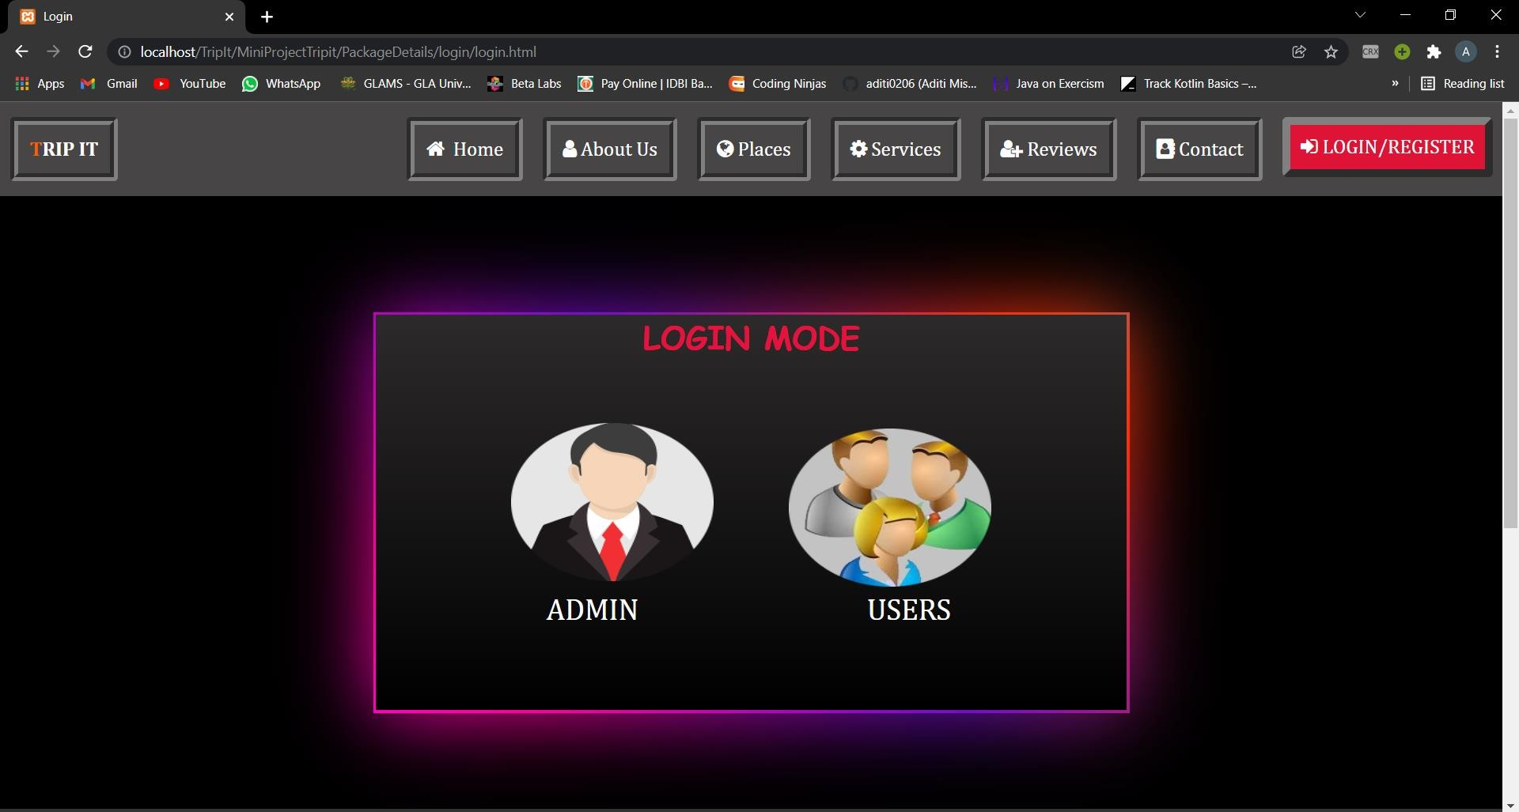

Slide 11
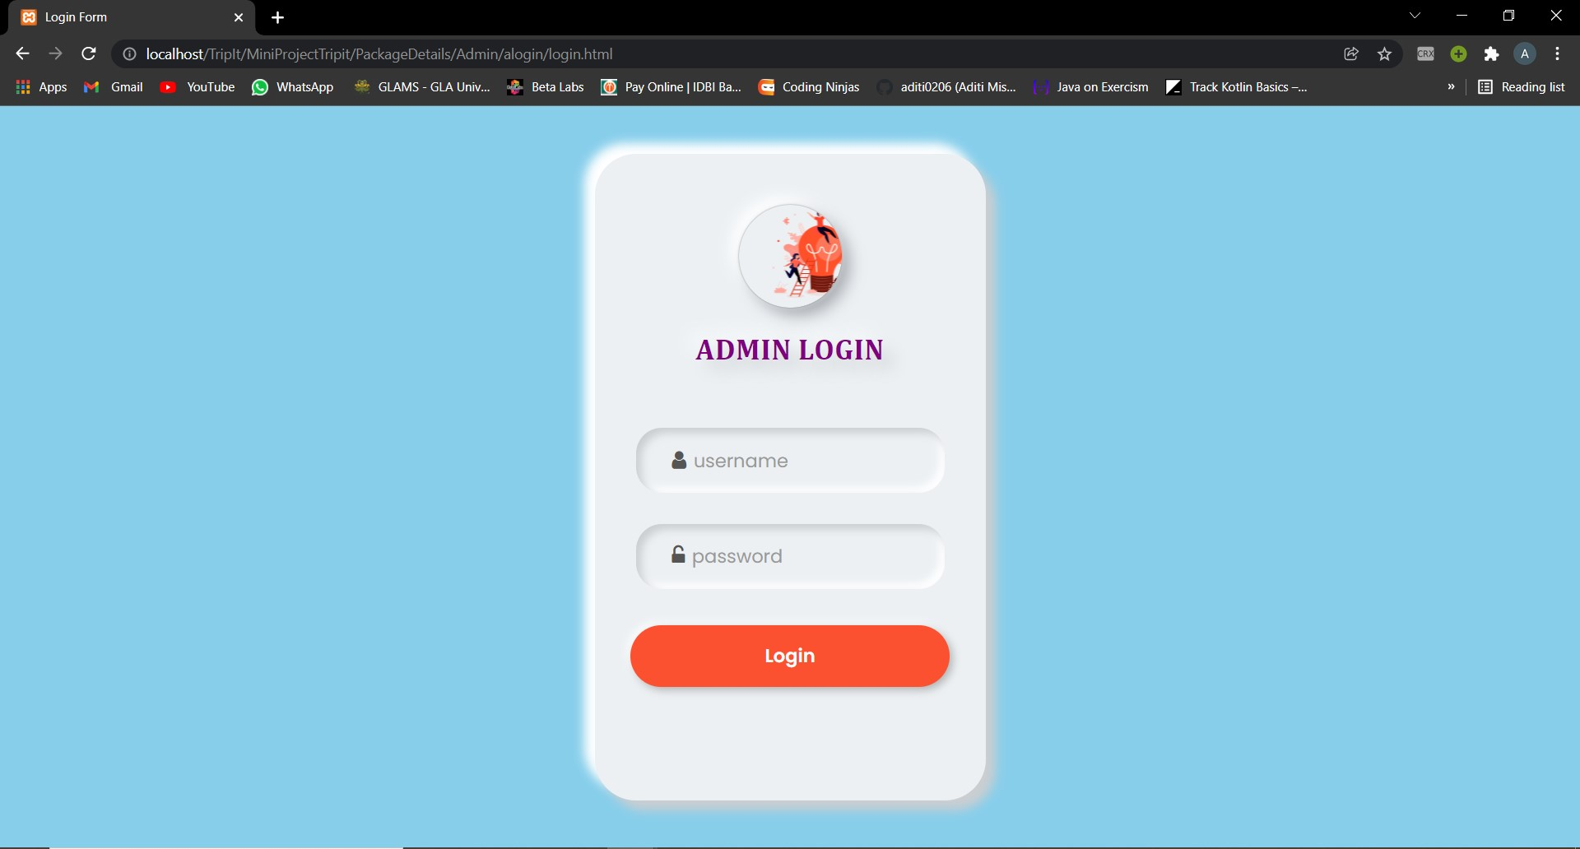

Slide 12
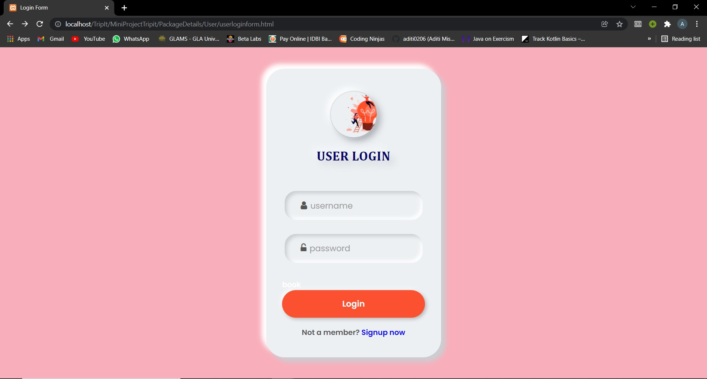

Slide 13
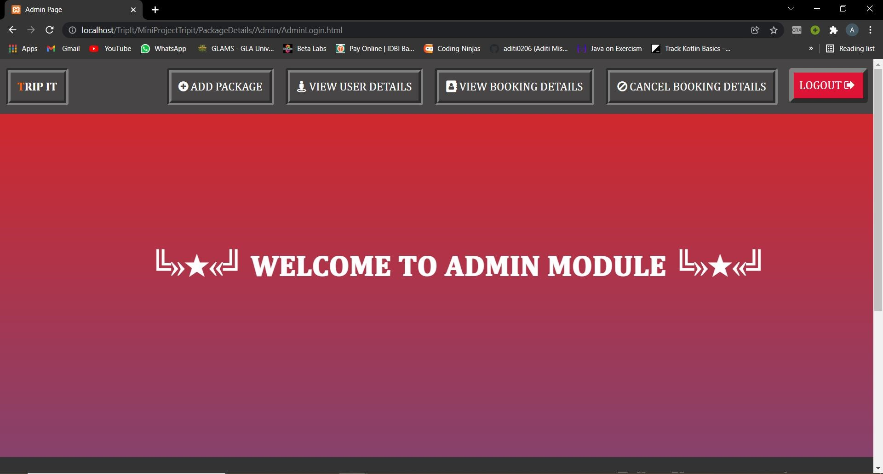

Slide 14
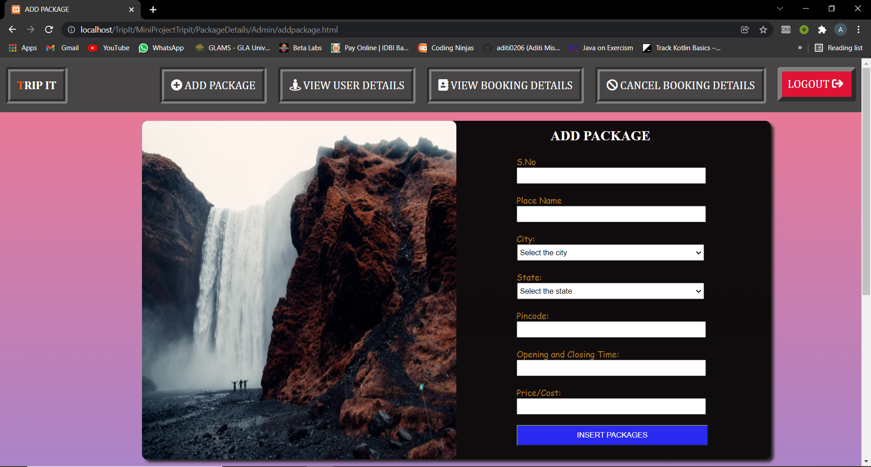

Slide 15
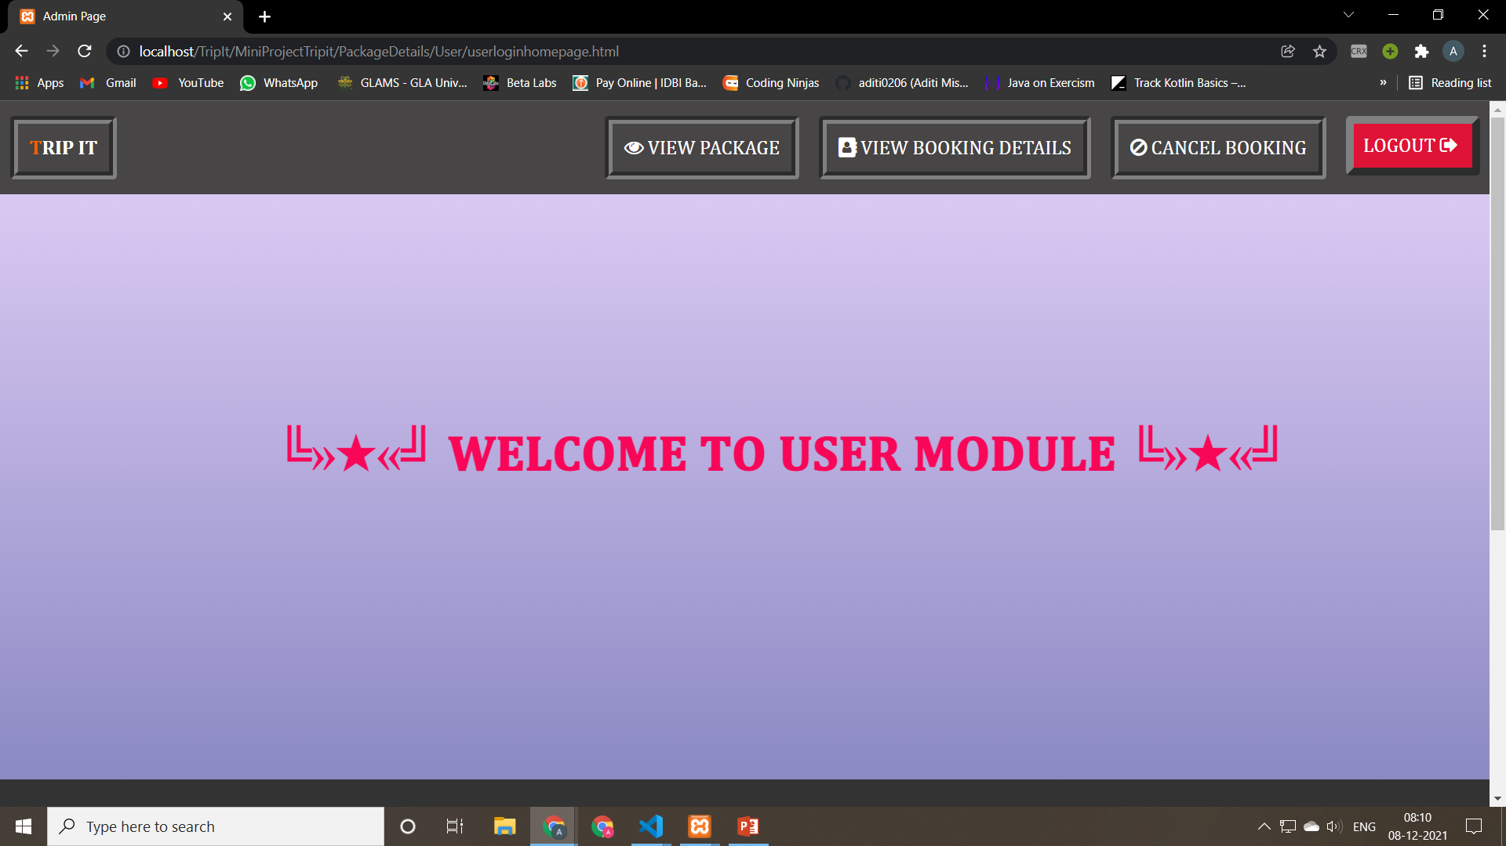

Slide 16
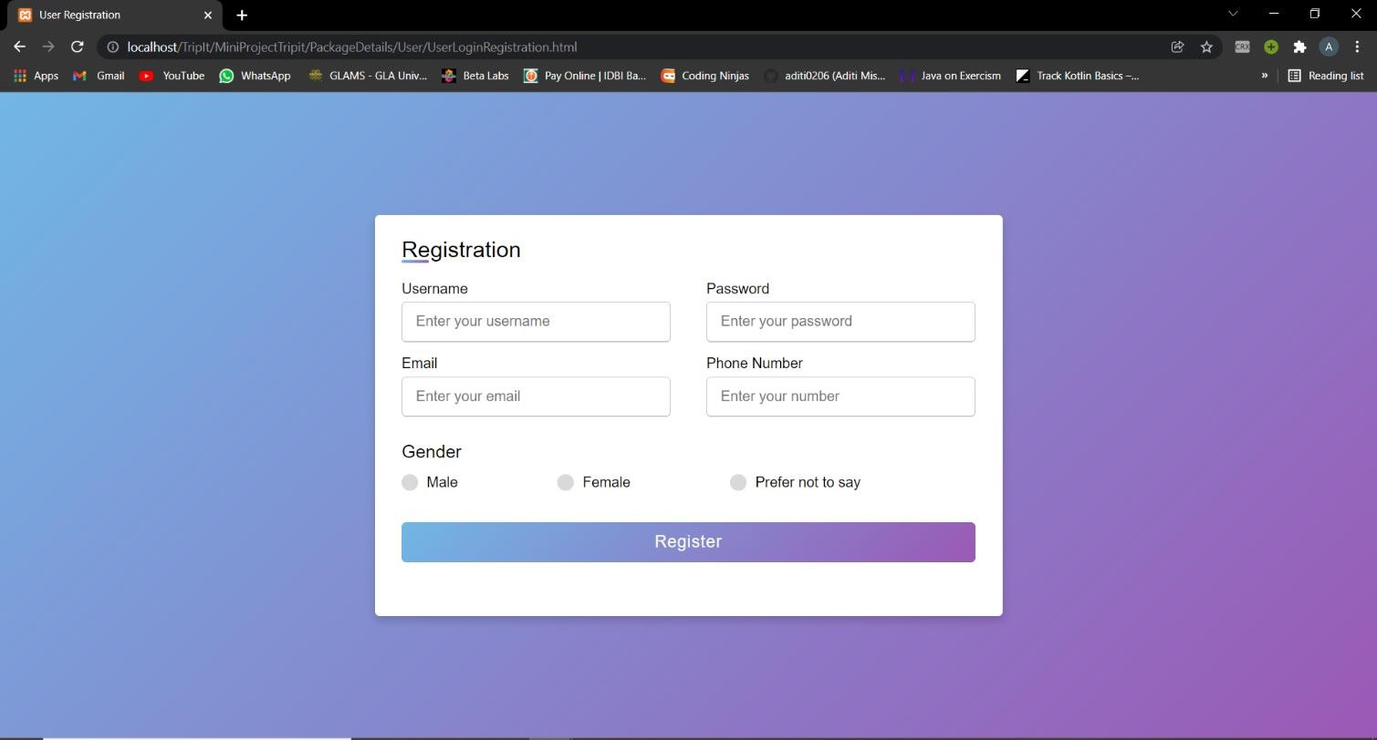

Slide 17
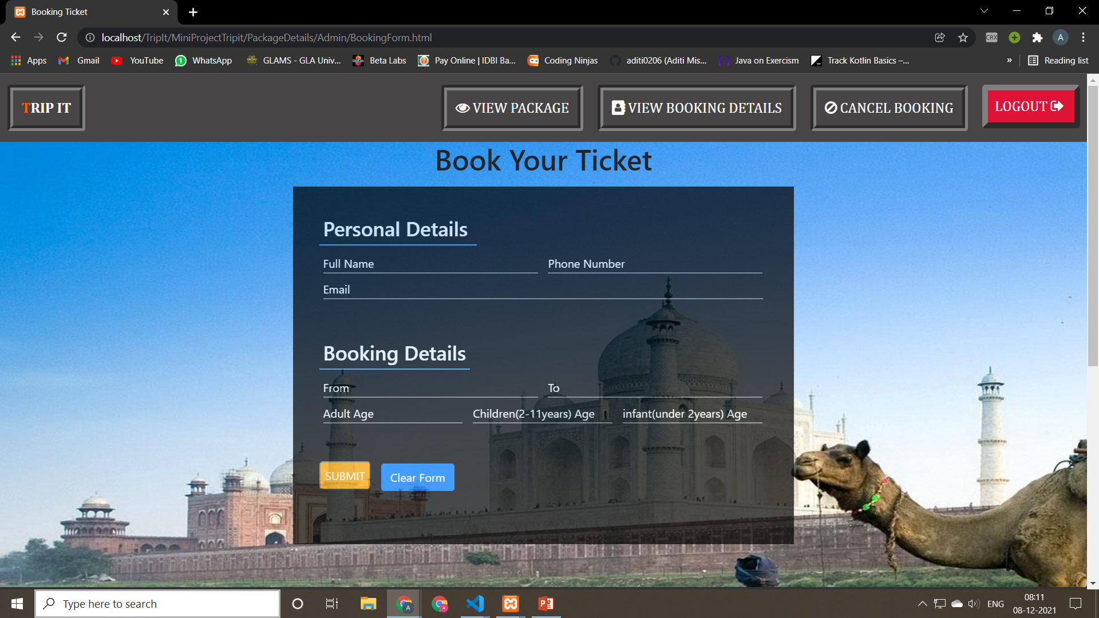

Slide 18
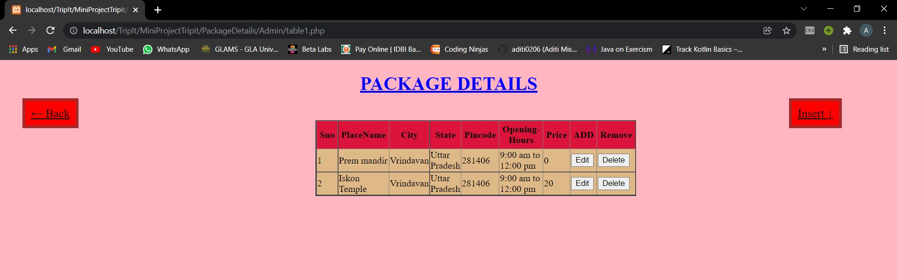

Slide 19
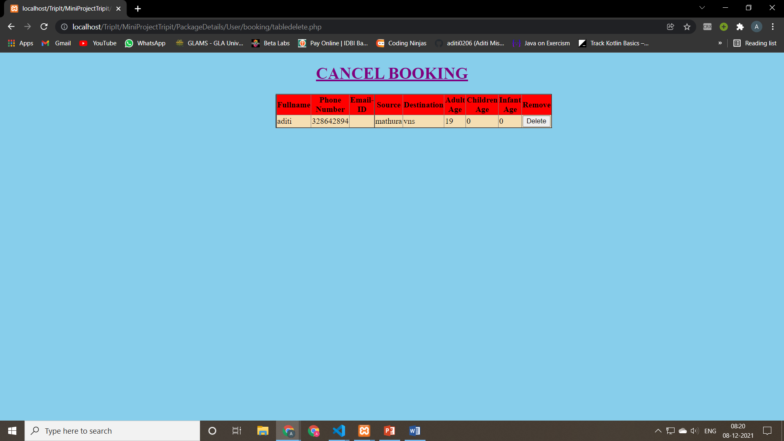

Slide 20
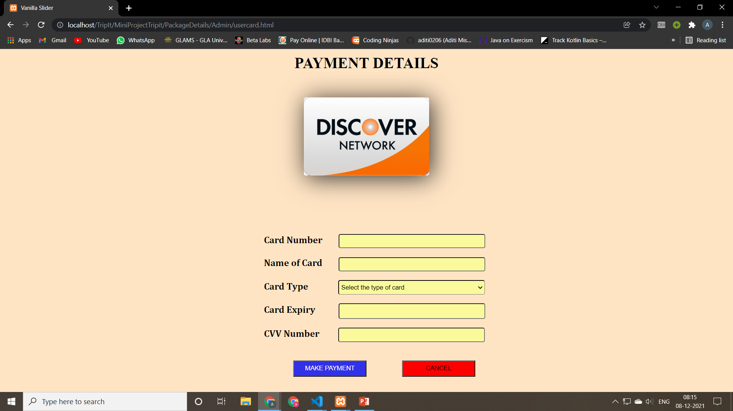
PAY NOW PAGE

Slide 21
FUTURE SCOPE OF THE PROJECT
->”Trip It” displays features such as online registration, booking ticket, packages
etc.
->Modification can be done if required.
->Extension of project using modules and functions can be done in future
->Modules are easily accessible and modifiable
->Modules that can be added are like:
+Taking care of tourists,
+Hospitality management,
+Dynamic addition of packages across India.

Slide 22
CONCLUSION
->Navigation through site is easy
->Fast processing and immediate result with high security
can be attained by our project.
->It also simplifies management process in travelling as everything
can be accessed and site can be easily used by everyone.
->Whenever clicked on any module, immediate results are shown
then and there.

Slide 23
THANK YOU!

